Slide 1

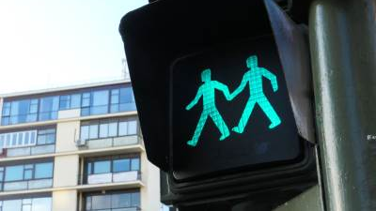
Pedestrian Safety and Environmental Justice in Boston
By Emmett Greenberg

Slide 2
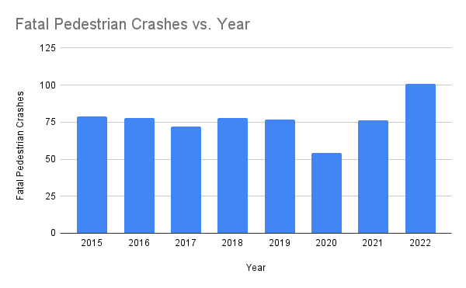
Background
Pedestrian safety is a critical issue in Boston and Massachusetts
Pedestrian deaths increased 35% in 2022, according to advocacy group WalkBoston
101 pedestrians were killed by vehicles in 2022
Source: WalkBoston (https://storymaps.arcgis.com/stories/5ef0c0ec60764c85a7e6ace69b752fd4

Slide 3


Background
Certain populations may be more vulnerable to a lack of safety on foot
Environmental Justice Census Block groups represent communities that meet any of three demographic criteria:
Low-income status
High percentage of minority population
Low rates of English proficiency
In 2022, 71% of fatal pedestrian crashes took place in Environmental Justice Census Block Groups
Source: https://www.goredforwomen.org/en/news/2022/04/13/connecting-health-pollution-and-fairness-thats-environmental-justice

Slide 4
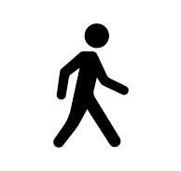
Research Questions
Which communities in Boston…
Have the highest concentrations of pedestrian crashes?
Have poor-quality pedestrian infrastructure?
Have a high number of safety concerns?
Focus on Environmental Justice communities (census block groups)

Slide 5
Analytic Strategy
Get crash count data and select the crashes involving pedestrians
Create density plot of pedestrian crashes
Get data on quality of pedestrian facilities
Get data on reported safety concerns at intersections
Select only where travel mode is “pedestrian”
Spatial join data with Environmental Justice census block groups
Apportion totals to census block groups

Slide 6
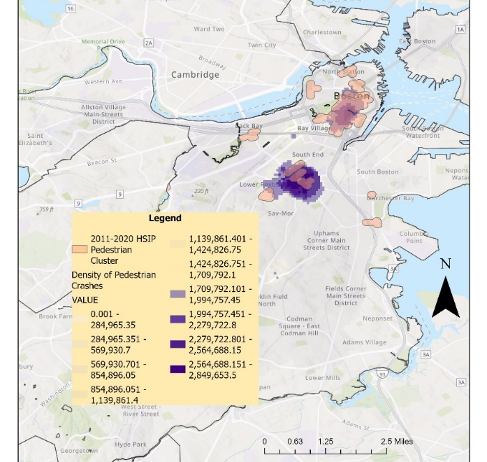
Analysis
Kernel Density Plot of Pedestrian Crash points from advocacy group Vision Zero (shown in purple)
Pedestrian crash cluster polygons from MassDOT (shown in pink)
Both produced roughly similar results

Slide 7
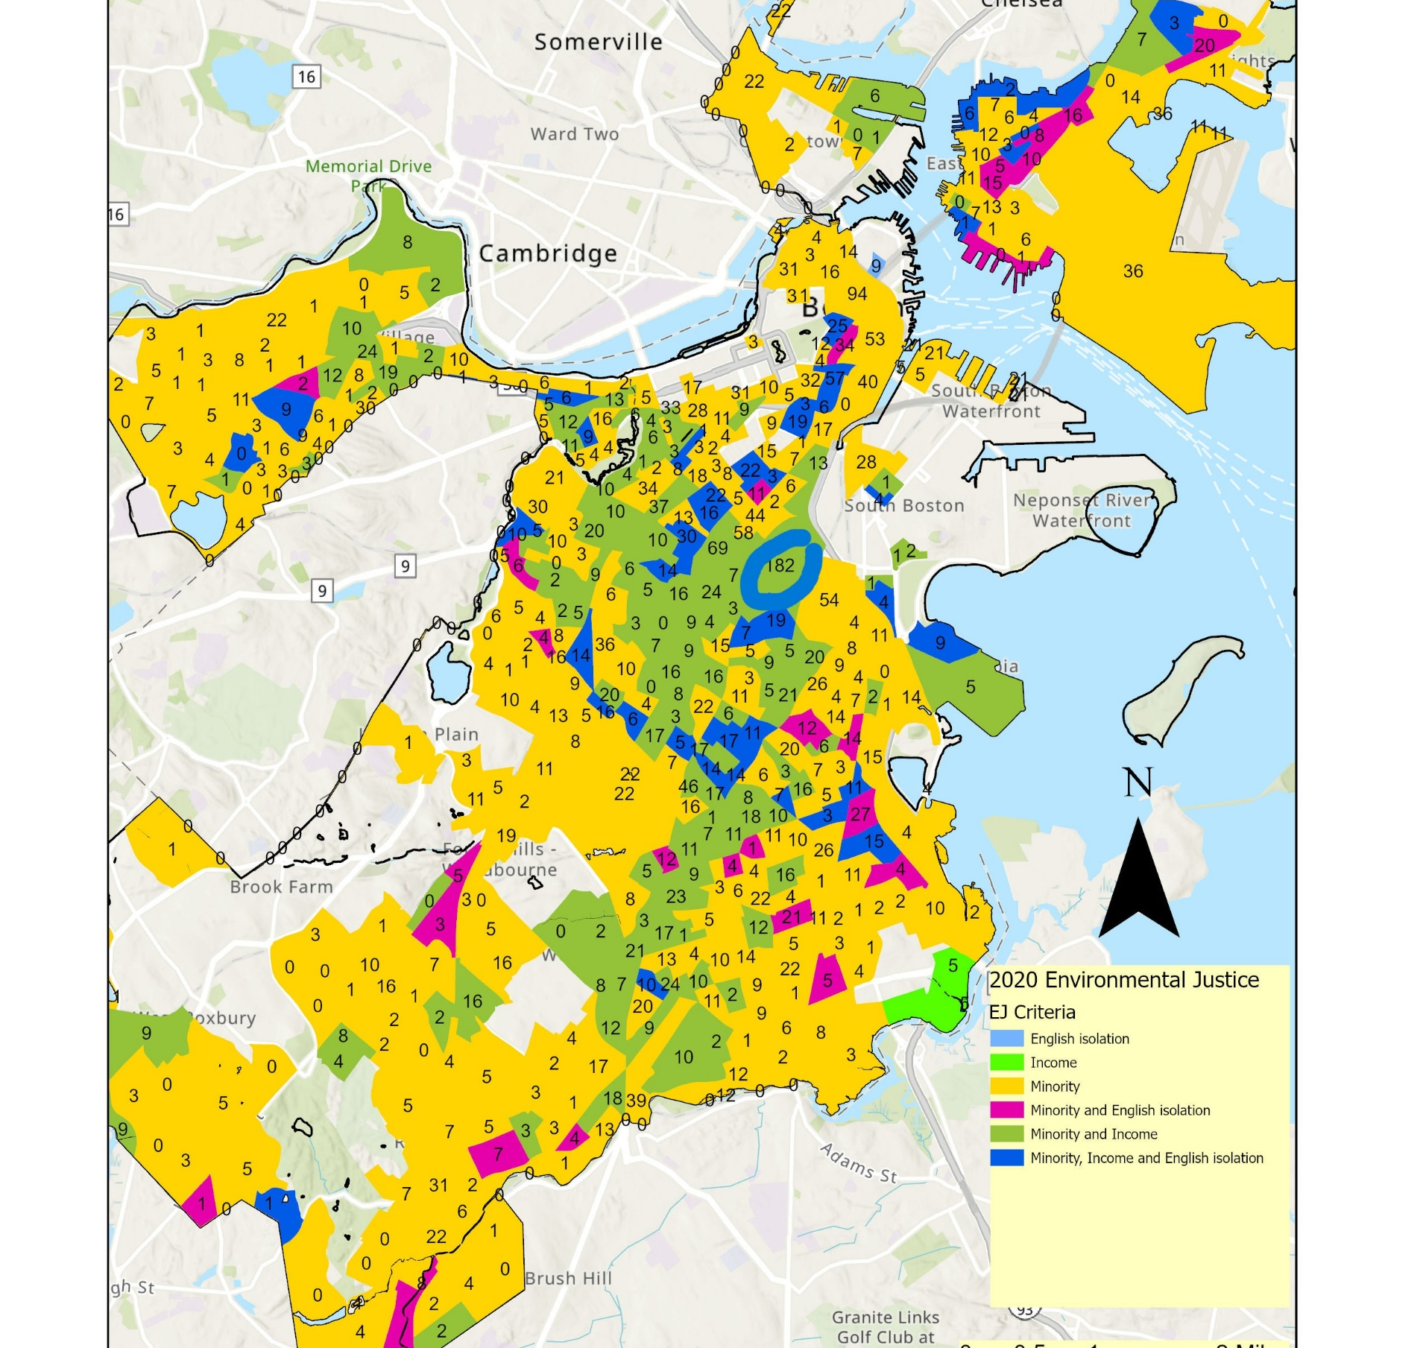
Analysis
2020 Environmental Justice Block Groups with total pedestrian crash counts
Highest total: 182 (shown in blue circle)
This EJ block group meets minority and low-income criteria

Slide 8
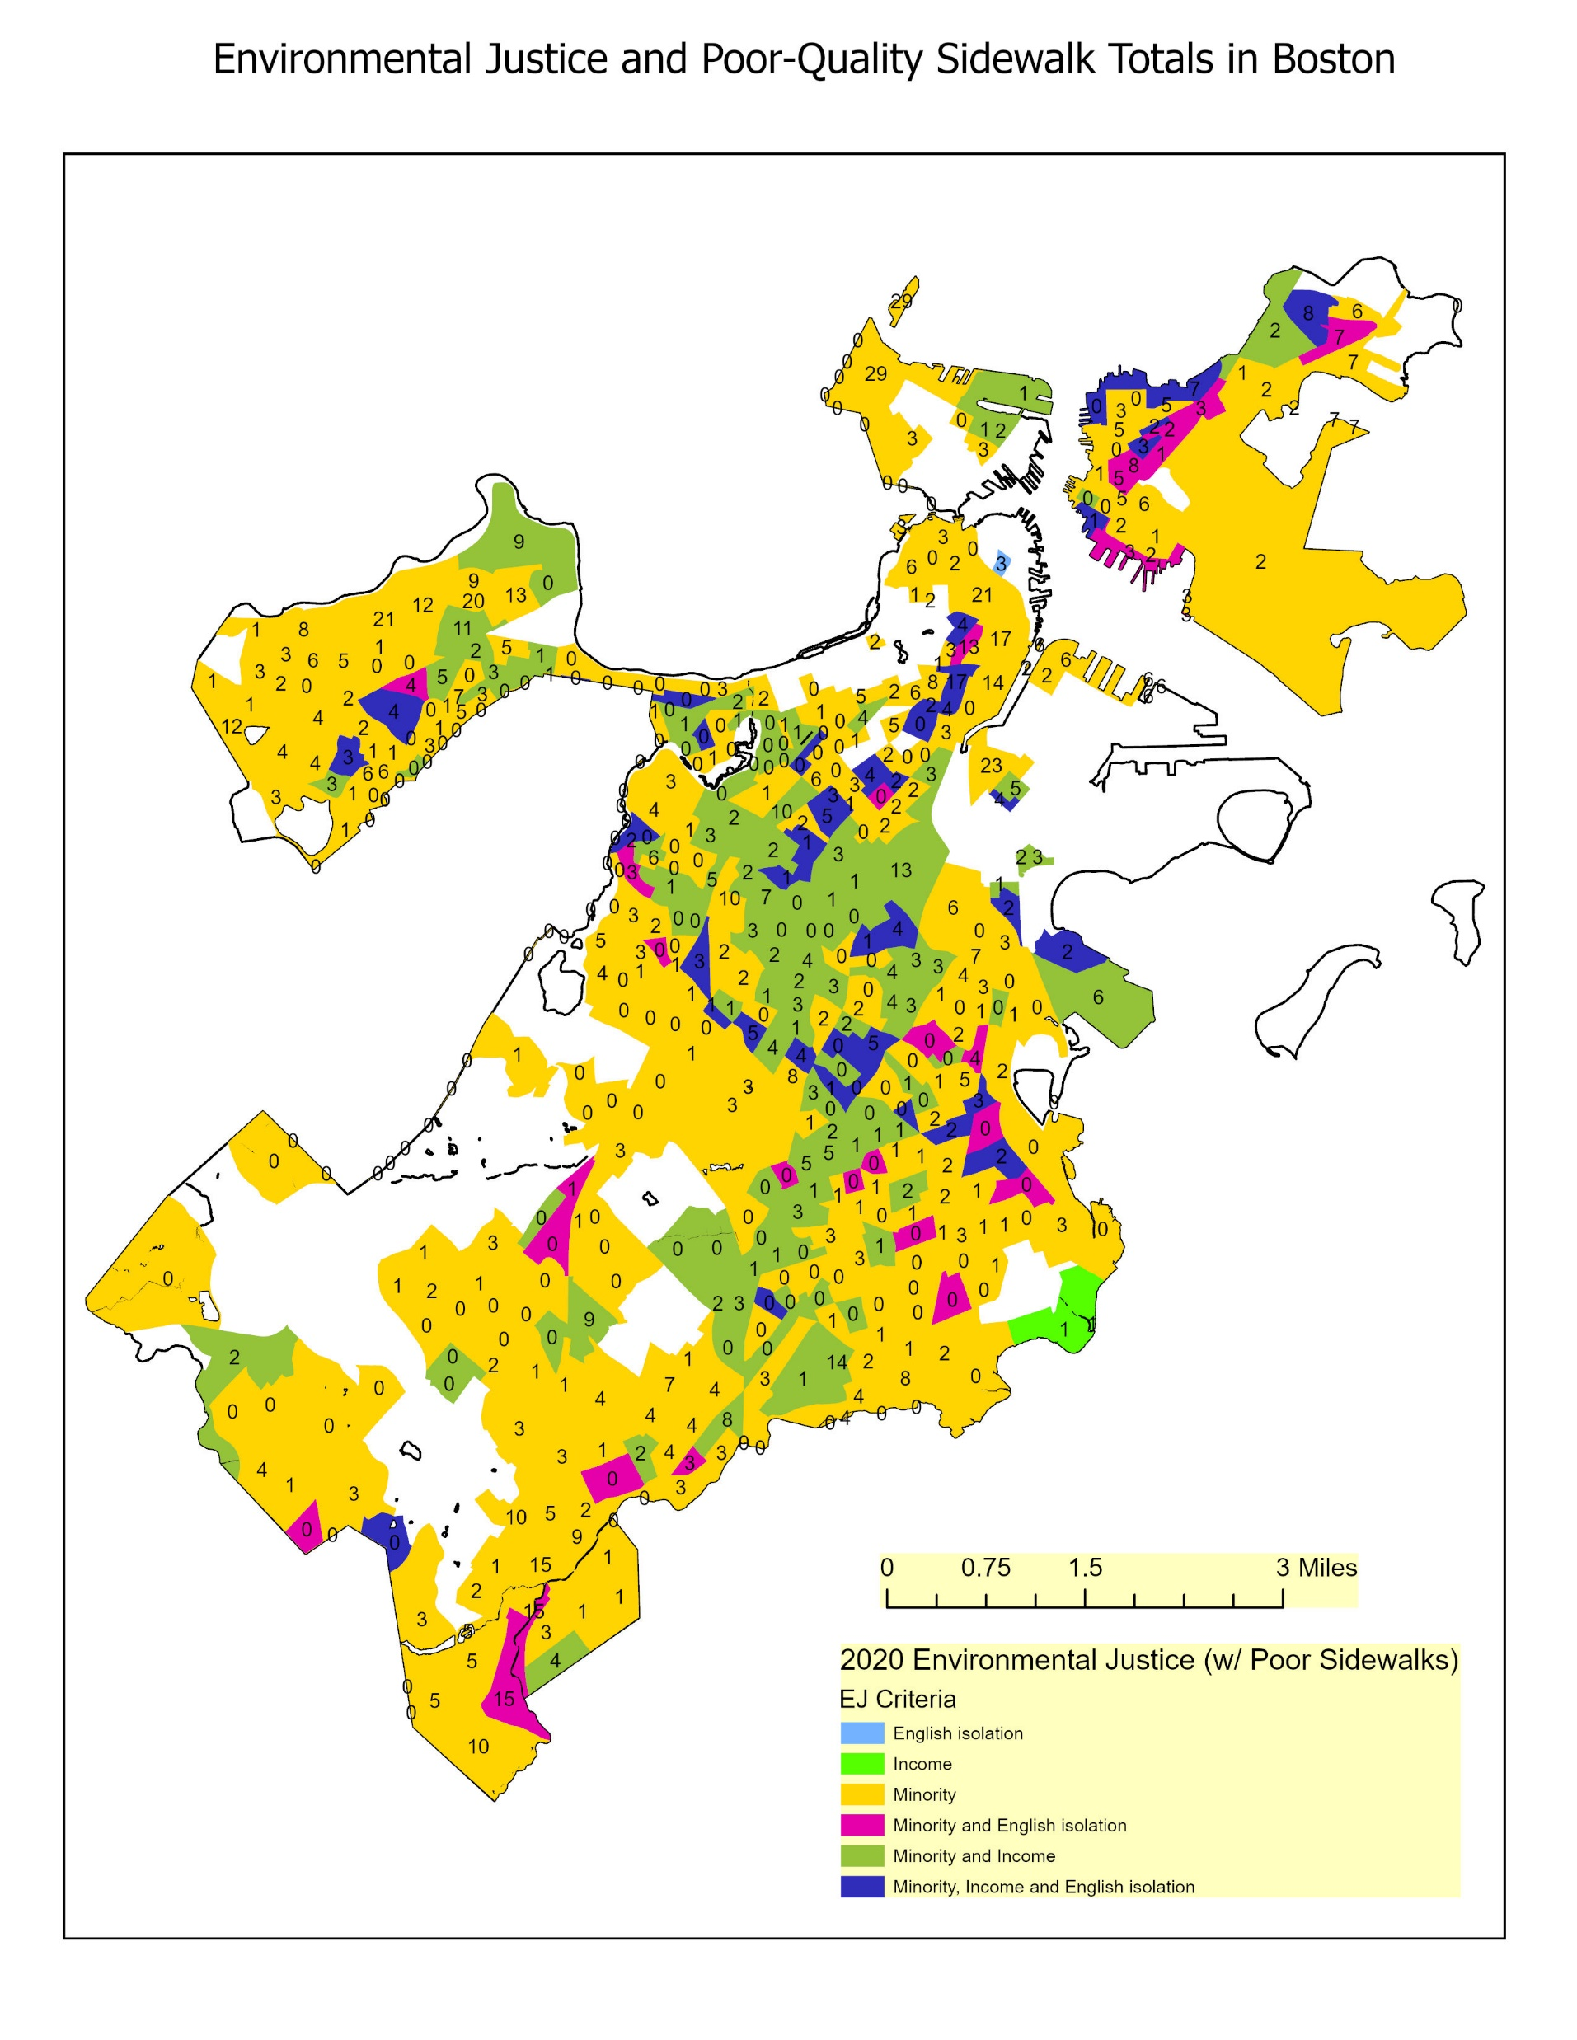
Analysis
2020 EJ census block groups with count of pedestrian facilities in poor condition (according to MassDOT’s Massachusetts Road Inventory)
Same EJ block group has 13 pedestrian facilities (sidewalks/ramps) in poor condition (only the 12th-most)
EJ block groups with highest totals located downtown and meet minority criteria

Slide 9
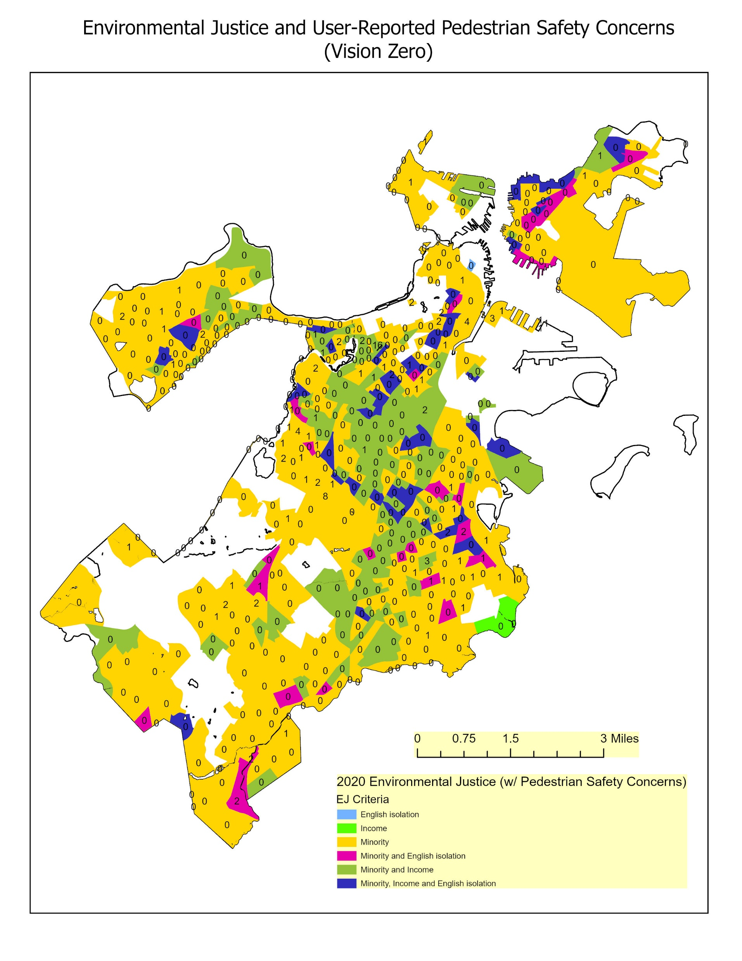
Analysis
2020 EJ census block groups with total count of Vision Zero safety concerns (user-reported via app)
EJ block group that had most crashes has two reported safety concerns for pedestrians (t-5th most)

Slide 10
Conclusions
No clear correlation between pedestrian crash counts and any of the EJ criteria
Potential moderate correlation between crashes and poor pedestrian infrastructure
More data/variables are likely needed to explain pedestrian crash counts
Traffic-related data
Car ownership (or lack thereof)

